Slide 1
Welcome to
Fifth Grade Open House!
Please...
Sign in
Sign up for Conferences
Green Post-It: Note for Miss S
Orange Post-It: Note for Child
In your child’s folder you will find :
Clip System Info and Class Rules
Our first writing piece of the year
Specials Schedule
SeeSaw Login
Student Contact Info.
Notes:
In your child’s folder you will find a couple things:
A letter from your child
Our first writing piece of the year (some did not finish)
Clip System Info
Class Rules
Approved snacks
Reading Log information
*Please feel free to take some time to write your child a letter home. They will love it when they come in the morning :)

Slide 2
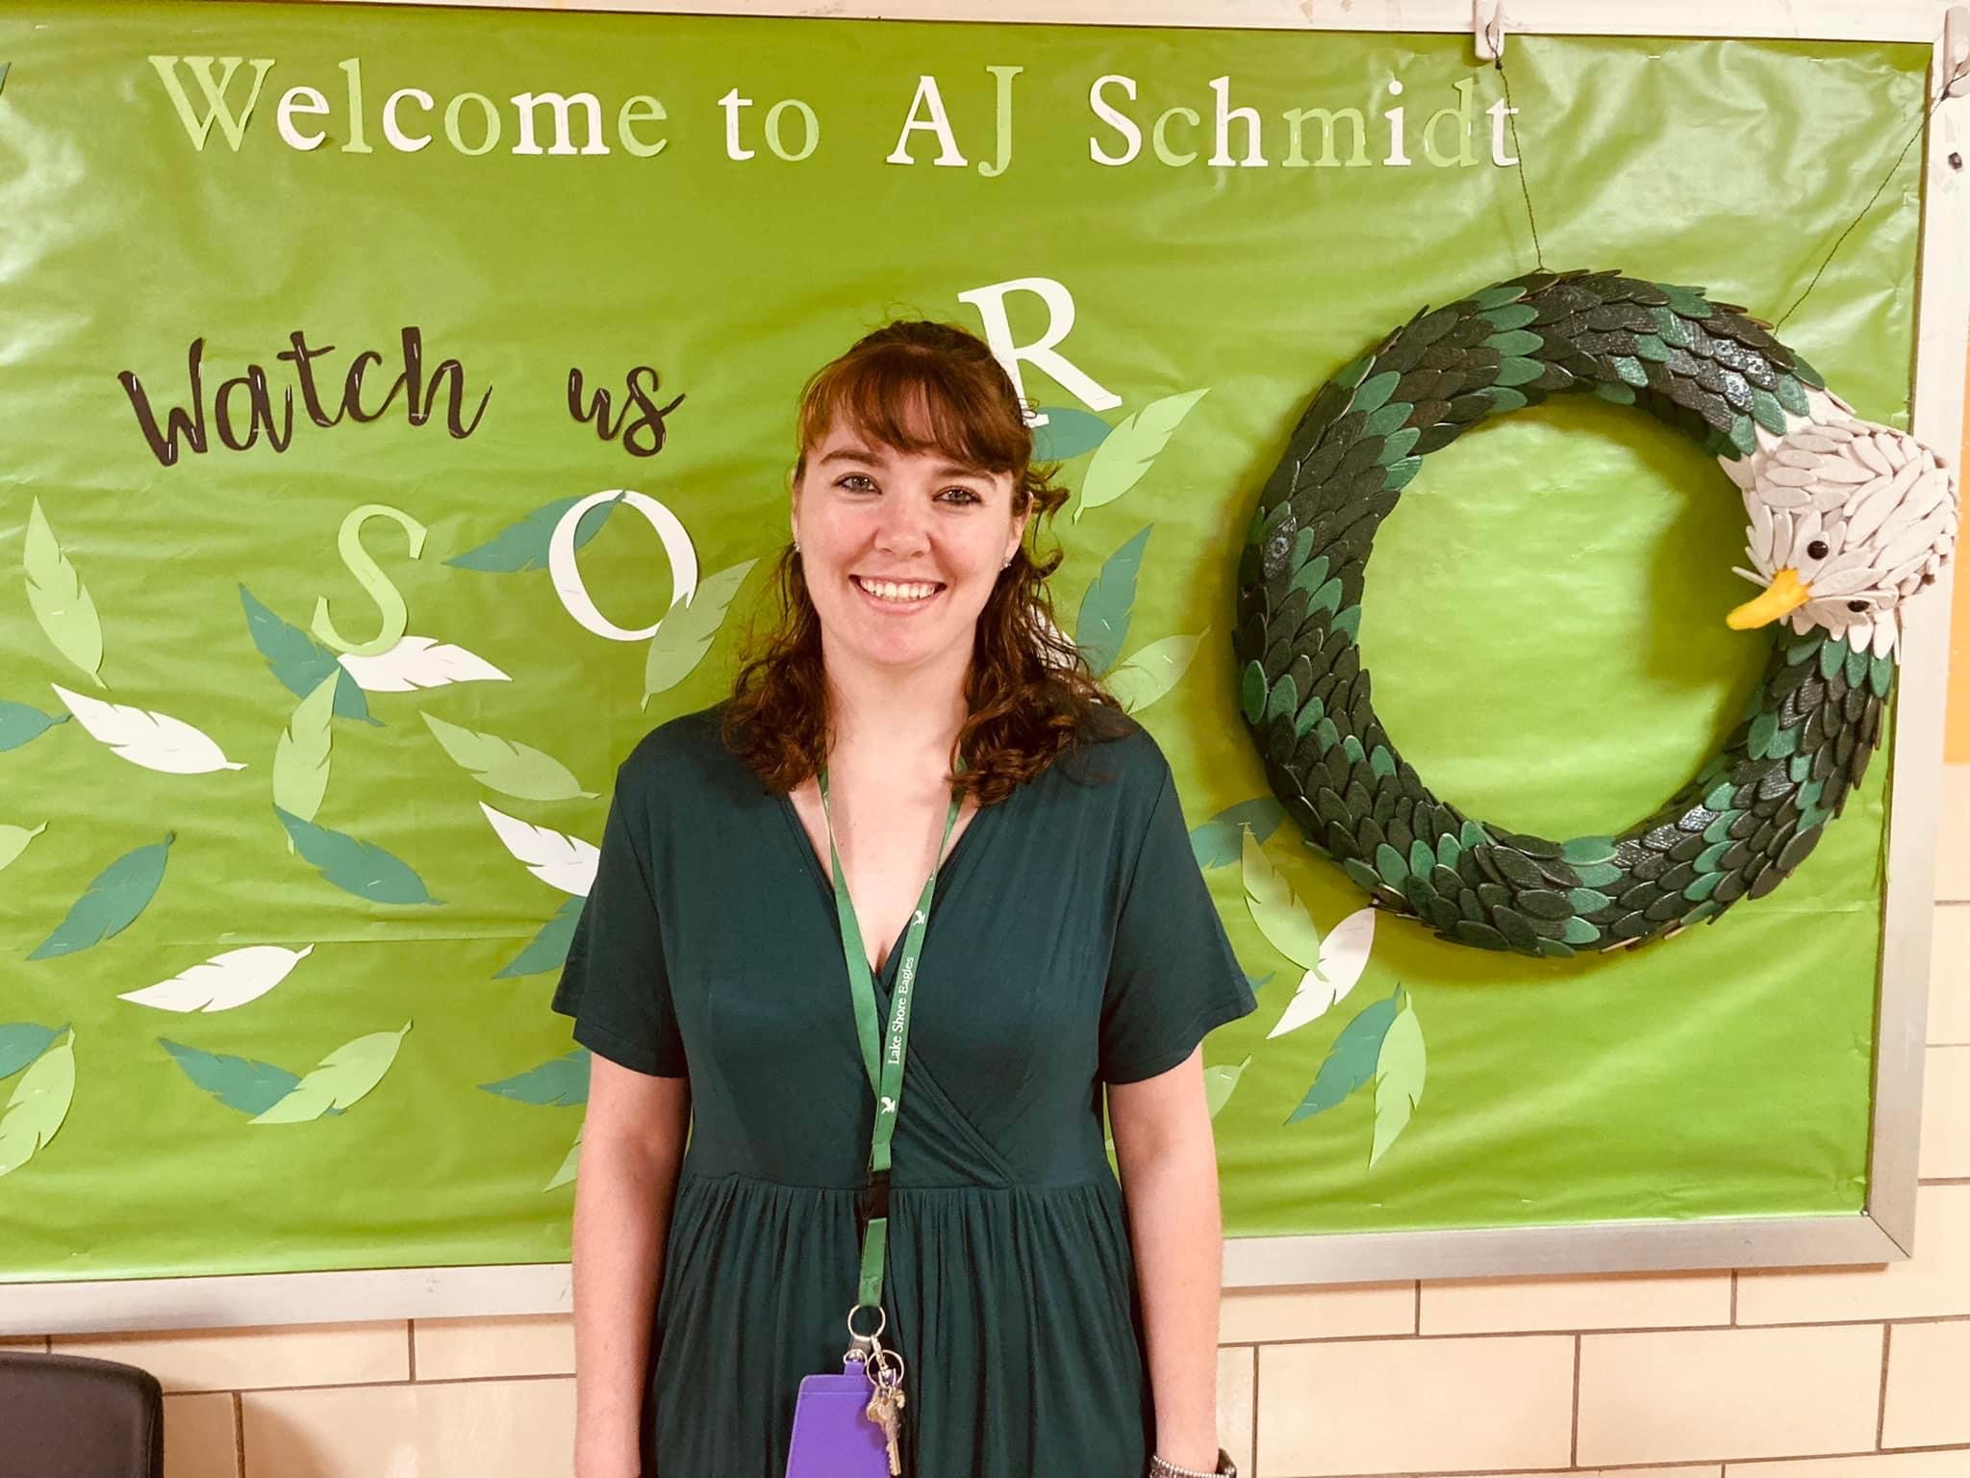
Meet Miss Salansky
Taught 1st, 2nd and 4th Grade
Fifth year teaching (including 1 year of subbing)
Studied at Canisius College for my Undergrad in Early Childhood and Childhood Education
Studied at Saint Joseph’s University for Graduate School in Special Education

Slide 3
Classroom Management

Slide 4
Bring Everyday...
Take Home Folder- to be checked daily for important papers, graded work, Class Newsletter(sent home on Mondays)
Healthy Snack and Water
Students should come to school everyday ready to learn!
Friday Folders: To be signed and returned on Mondays

Slide 5
DASA: Dignity for All Students Act
Bullying vs. Conflict
Tattle vs. Tell
*Forms accessible to students at all times*

Slide 6
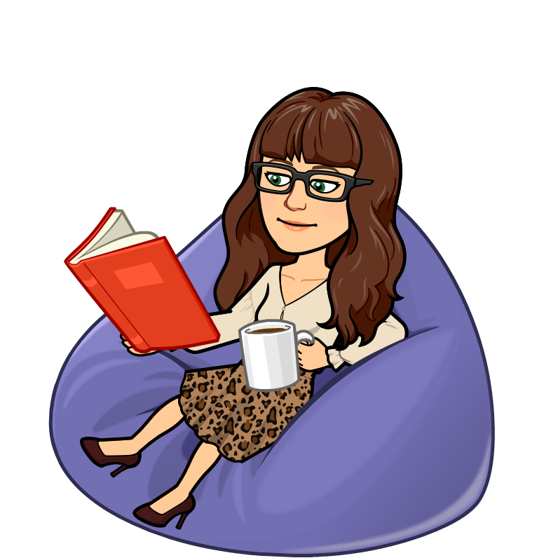
Flexible Seating
Student Choice
Student engagement
Collaboration
Communication
*A privilege that can be revoked at anytime by any one of the teachers*

Slide 7
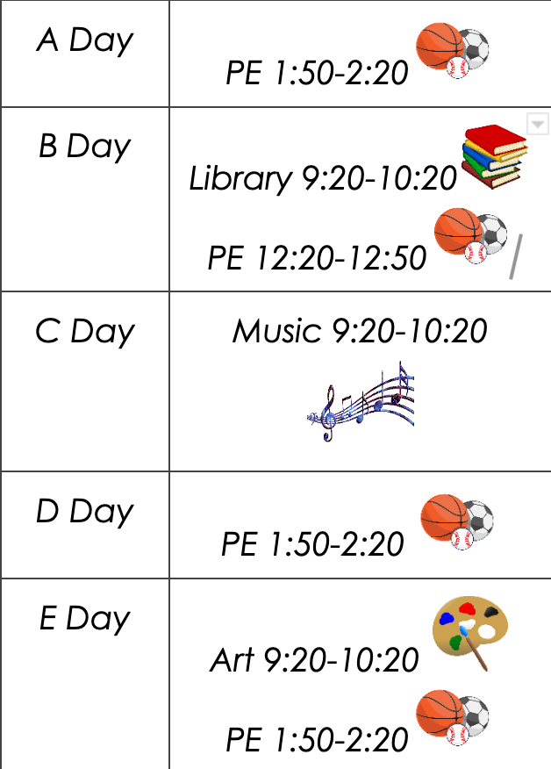
Specials

Slide 8
Fifth Grade ELA
We will work on...
Becoming a Close Reader and Writing to Learn
Researching to Build Knowledge and Teaching Others
Considering Perspectives and Supporting Opinions
Gathering Evidence and Speaking to Others
Grammar
Fountas & Pinnell Reading Program for Guided Reading, Interactive Read-Alouds and Mini-Lessons
Notes:
Add or double check
Right now we are reading the Great Law of Peace to work on these skills.

Slide 9
Fifth Grade Math
Resources for Home
Zearn
IXL
Khan Academy
Module 1: Place Value and Decimal Fractions
Module 2: Multi-Digit Whole Number and Decimal Fraction Operations
Module 3: Addition and Subtraction of Fractions
Module 4: Multiplication and Division of Fractions and Decimal Fractions
Module 5: Addition and Multiplication with Volume and Area
Module 6: Problem Solving with the Coordinate Plane
Whole Group Instruction
Small Group Instruction
Math Centers 2-3 days
Focus on:
Fluency
Accuracy
Problem Solving
Word Problems

Slide 10
Science & Social Studies-
Will rotate after each unit
*
•Social Studies (PNW Boces)
Early Civilizations, European Exploration,
Geography/Western Hemisphere, U.S. Government)
•Science (Mystery Science)
Web of Life (Ecosystem)
Chemical Magic
Spaceship Earth (Sun, Moon, Starts, Planets)
BOCES Kit: Ecosystems (guppies and snails)

Slide 11
Guided Reading
Small groups with Miss Salansky and Mrs. Koch
Individualized to student’s reading levels
Focus on:
Reading Fluency - accuracy, expression and speed
Grammar and Writing- sentence and paragraph structure
Spelling - leveled spelling tests weekly

Slide 12
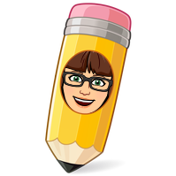
Writing
*Infused into our F & P units
Student Notebooks allow:
readers to think on paper within, beyond, and about the text
try nonfiction genres as they respond to what they read teachers to discover
a simple, powerful tool for ongoing assessment
*Narrative, Opinion, Informational
*Writers’ Workshop Style
On-Demand Writing using A.C.E.S

Slide 13
IRA and Mini-Lessons
Interactive Read Aloud (IRA)
Interactive read-aloud is a whole-group instructional context in which you read aloud a selected text to the whole class, occasionally and selectively pausing for conversation. Students think about, talk about, and respond to the text as a whole group or in pairs, triads, or quads. Both reader and listeners actively process the language, ideas, and meaning of the text.
Mini Lessons
Reading Mini Lessons are short, concise, explicit, inquiry-based lessons about a principle that students can apply to their own independent reading

Slide 14
Homework Policy
Please check your child’s agenda daily for behavior and homework
Your child’s daily homework is to read a book of their choice.
If you notice that your child is struggling with the material please contact us so that we can help come up with a solution.

Slide 15
Communication
SeeSaw- Student portfolio, parent/teacher communication, class updates, test reminders
Google Classroom- Teacher/Student Collaboration
Please feel free to contact me with any concerns, positive news!
Email: alexandria.salansky@lscsd.org
Phone: 716-926-2774

Slide 16
Thank You!
Thank you...
For your continuous support
Sharing your child with AJS
Joining us tonight
I look forward to the opportunities that will come out of working with all of your children this year!

